Slide 1
LOGIN
NAME
EMAIL
PASSWORD
FORGOT PASSWORD
LOGIN
REGISTER

Slide 2
REGISTER
NAME
EMAIL
PHONE NUMBER
DATE OF BIRTH
PASSWORD
CONFORM PASSWORD
REGISTER
Already registered LOGIN

Slide 3
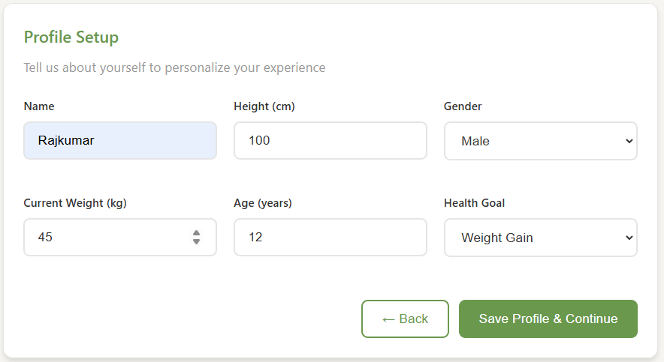

Add image
60
Active factor
Sedentary
Lightly active
Moderately active
Very active
Extra active

Slide 4
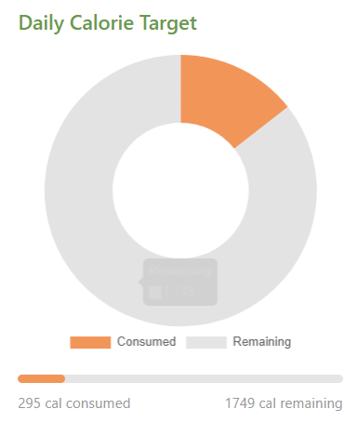
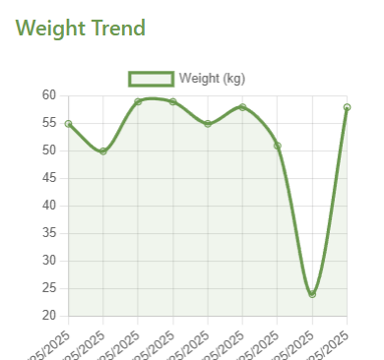

Back to profile
goal
Weight gain
BMI
45
Calory target
45
Water target
1400 ml
Food items
Total calory
Name
Food name
cal
x
Food name
cal
x
Food name
cal
x
Food name
cal
x
320/1400 ml
undo
--- ml
add
Search food
add
200 ml
x
rice
egg
milk
fish
potato
120 ml
x
chicken
bread
banana
pasta
apple

